Slide 1

Company Introduction
Wise Trader
Auto part Business
Why on S.M.M
Benefits

Slide 2

BRAND NAME & LOGO
My Brand Name is Wisdom & it’s logo is Eagle.
Logo Story: The hunting red Eagle symbolizes Strength, Power and forward momentum, which depict our fast service and good quality of our products.

Slide 3
VISION
Become the most trusted Source
Providing Excellent Quality
Lead Market through Innovation
Mission
Provide Complete Range of Premium-Grade auto parts
Build Long term relation
Ensure value with every Purchase
Help everyone who want to Import

Slide 4
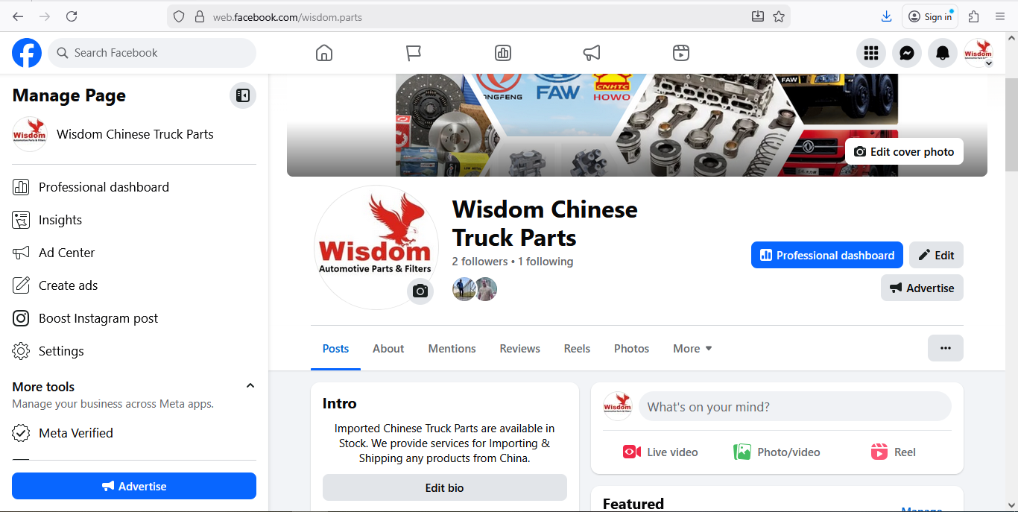
Facebook Page: Wisdom Auto motive Parts https://web.facebook.com/?_rdc=1&_rdr

Slide 5
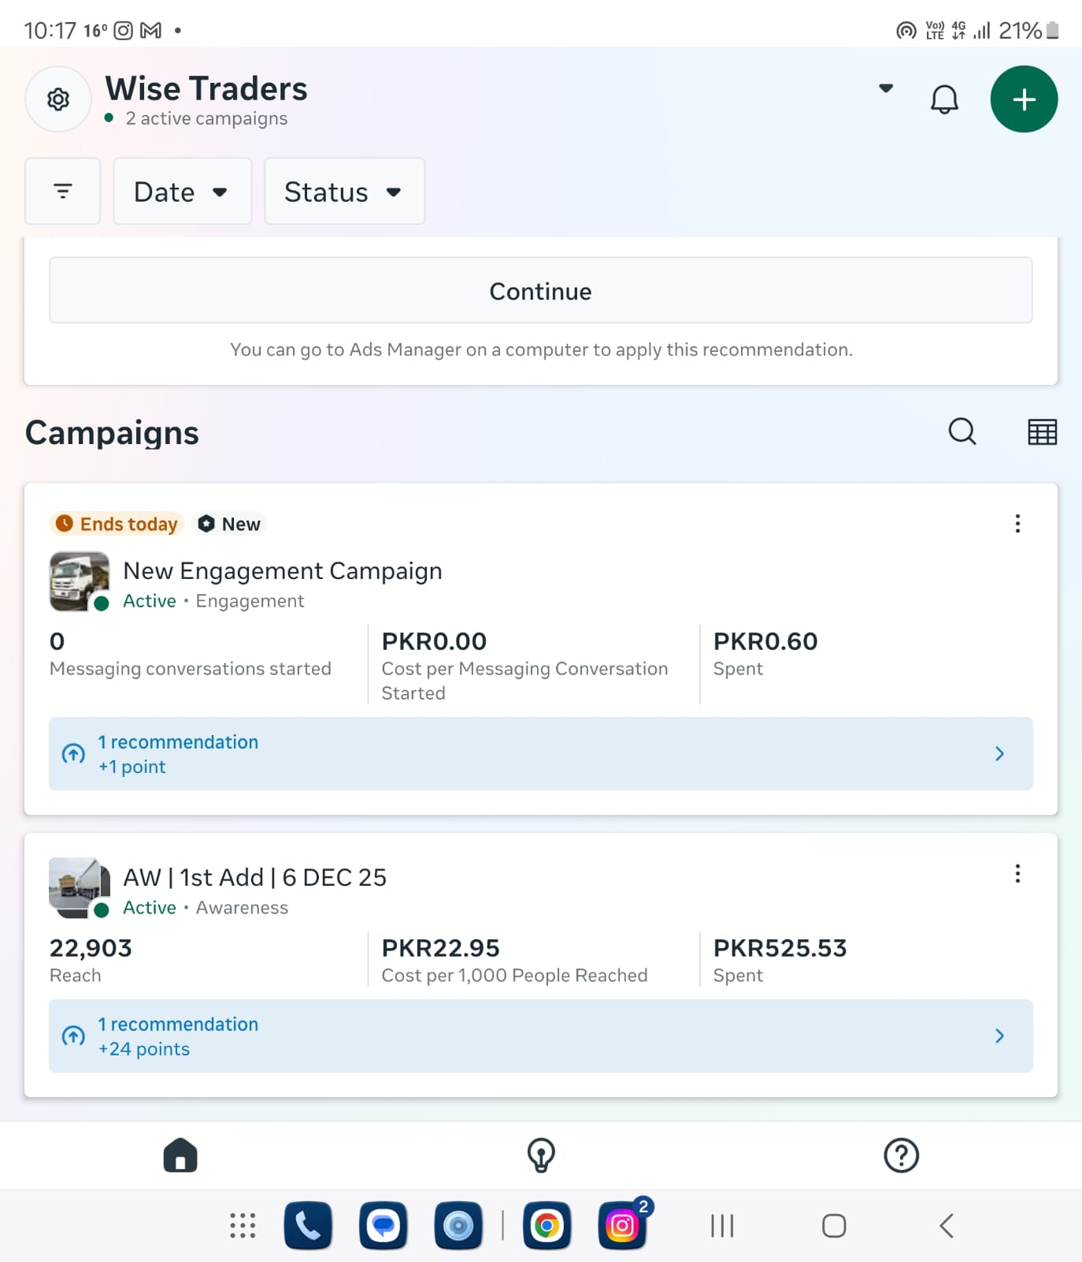
Facebook Ad Run Result https://adsmanager.facebook.com/adsmanager/manage/campaigns?business_id=810294115495107&act=832288715980624

Slide 6
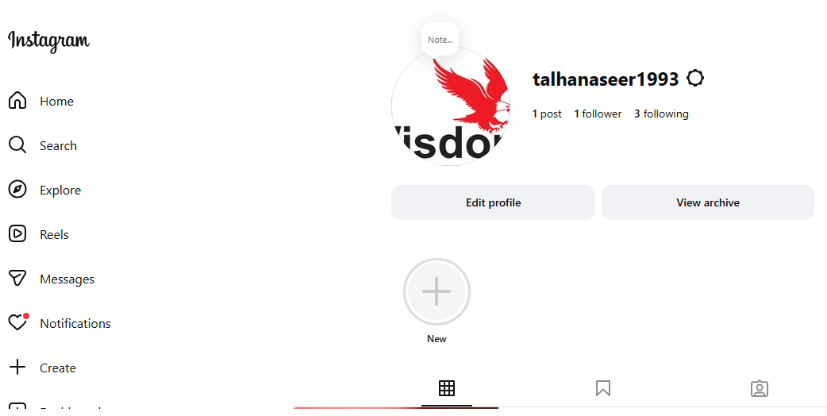
Instagram Page:talhanaseer1993 https://www.instagram.com/talhanaseer1993/?fbclid=IwY2xjawOg3xZleHRuA2FlbQIxMABicmlkETFmb0JGZk5ab2tiODh0b1hNc3J0YwZhcHBfaWQQMjIyMDM5MTc4ODIwMDg5MgABHgjYS2pz5E7bbDwwjfwk8nE5oaTTlvBaEVYYwAr-9XTGHS_i0fWCwIparqvT_aem_nUWQDtqPdWeUiIV9nO_KDA

Slide 7
Thank You

